Slide 1
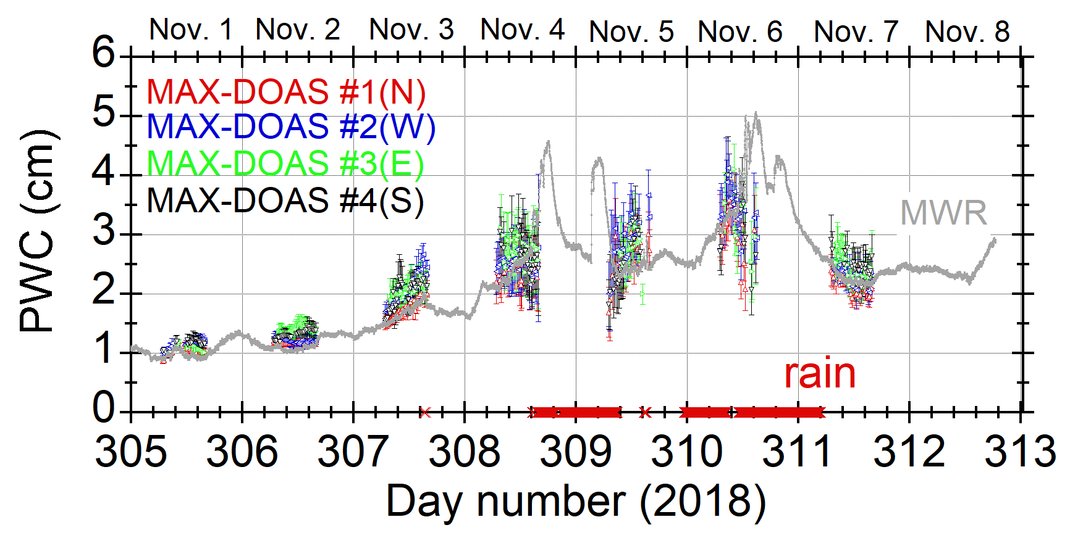
PWC comparison (MWR vs. MAX-DOAS)
Precipitable water content (g cm⁻² or cm) = VCD×18.0 / (6.02×10²³)

